Slide 1

Explaining Anatomical Shape Variability Johannes Kiechle – 16.11.2022

Slide 2
Raw Data
Preprocessing
Shape Analysis
linear
non-linear
ShapeWorks
Variational Graph AE
Particle Based Model
Mesh Registration
(Supervised) PCA / LDA
Conditional?
Supervised Disentangling
Latent
Reconstruction
Latent
Reconstruction
Evaluation

Slide 3
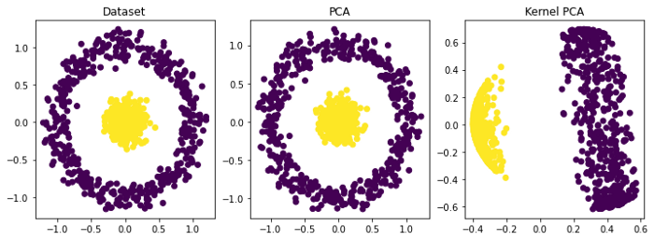
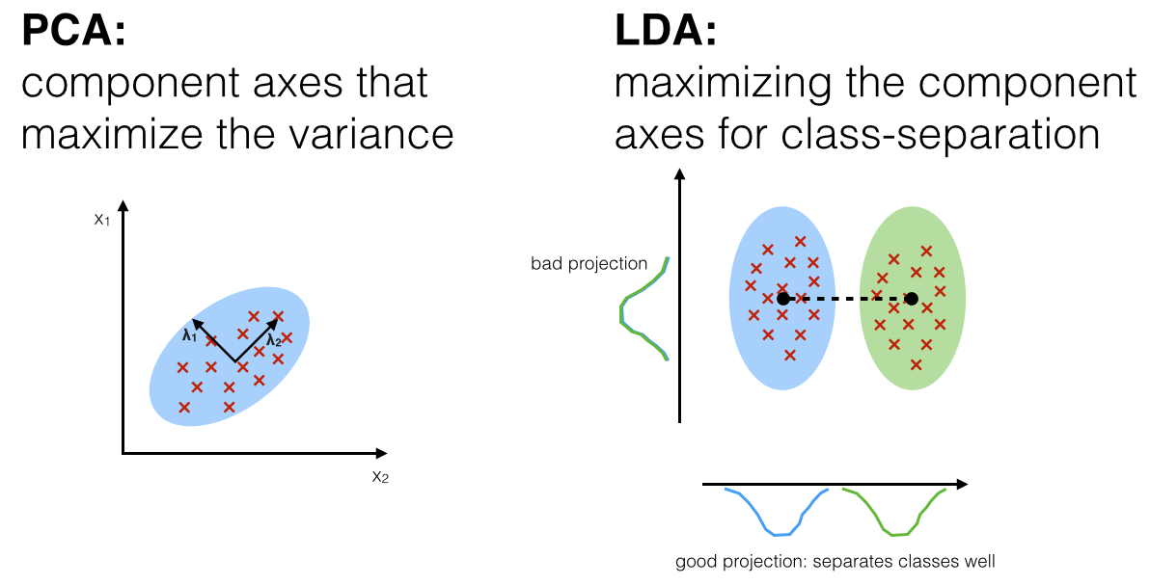
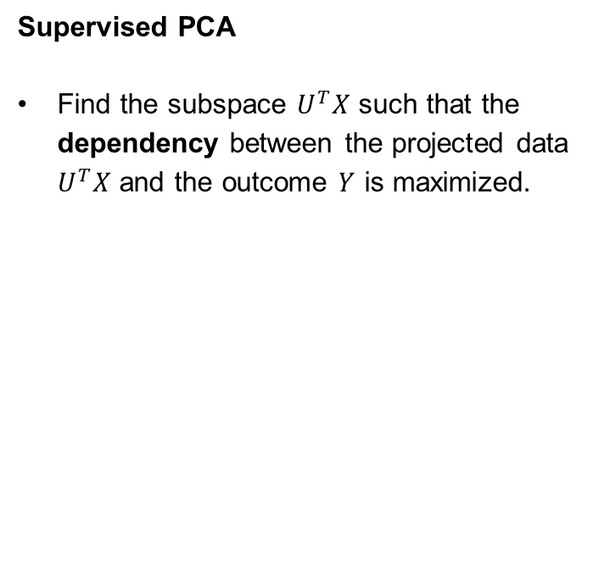
How to make PCA comparison more fair?
Find projection $U$ of original data $X$ such that first projection component points into the
direction of maximum variance of a given factor (e.g., age).
Supervised PCA
Find the subspace $U^{T}X$ such that the dependency between the projected data $U^{T}X$ and the outcome $Y$ is maximized.
Linear Discriminant Analysis (LDA)
Find a linear combination of features that characterizes/separates two or more classes of objects.

Slide 4
Raw Data
Preprocessing
Shape Analysis
linear
non-linear
ShapeWorks
Variational Graph AE
Particle Based Model
Mesh Registration
(Supervised) PCA
Supervised Disentangling
Latent
Reconstruction
Latent
Reconstruction
Evaluation

Slide 5
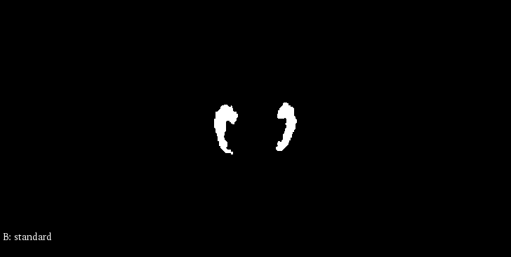
Raw Data
Binary hippocampus segmentations¹
1 mm isotropic voxel size
[1]: Hippocampus segmentation on high resolution diffusion MRI (Efird et al.)
20 mm
216 mm
220 mm

Slide 6
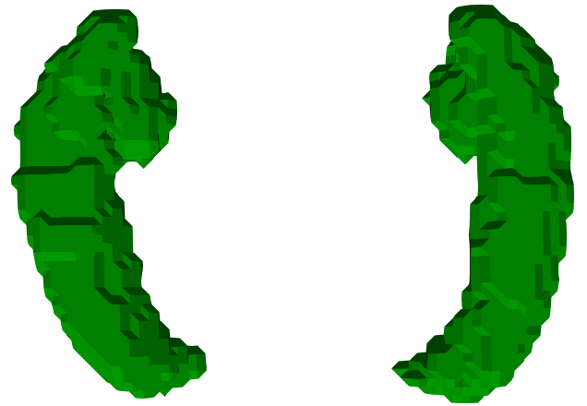
Raw Data
[1]: Marching cubes: A high resolution 3d surface construction algorithm (Lorensen et al.)
Marching Cubes¹

Slide 7
Raw Data
[1]: Marching cubes: A high resolution 3d surface construction algorithm (Lorensen et al.)
Preprocessing!
Marching Cubes¹

Slide 8
Raw Data
Preprocessing
Shape Analysis
linear
non-linear
ShapeWorks
Variational Graph AE
Particle Based Model
Mesh Registration
(Supervised) PCA
Supervised Disentangling
Latent
Reconstruction
Latent
Reconstruction
Evaluation

Slide 9
Preprocessing
Image Level
Padding
Distance Transform
Gaussian Blur
Image to Mesh
Marching Cubes
Mesh Level
Surface Smoothing
Procrustes Superimposion

Slide 10
Preprocessing
Image Level
Padding
Distance Transform
Gaussian Blur
Image to Mesh
Marching Cubes
Mesh Level
Surface Smoothing
Procrustes Superimposion

Slide 11
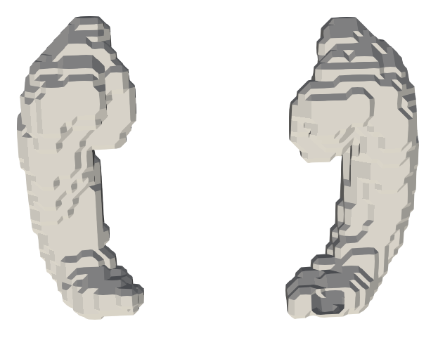
Preprocessing
Padding

Slide 12
Preprocessing
Distance transform:
A distance transformation converts a binary digital image, consisting of feature and non-feature pixels, into an image where all non-feature pixels have a value corresponding to the distance to the nearest feature pixel
Gaussian blur:
Gaussian blur feature is obtained by blurring (smoothing) an image using a Gaussian function to reduce the noise level
Nonuniform low-pass filter that preserves low spatial frequency and reduces image noise and negligible details in an image
Small Gaussian kernel is applied in order to preserve mesh topology

Slide 13
Preprocessing
Image Level
Padding
Distance Transform
Gaussian Blur
Image to Mesh
Marching Cubes
Mesh Level
Surface Smoothing
Procrustes Superimposion

Slide 14
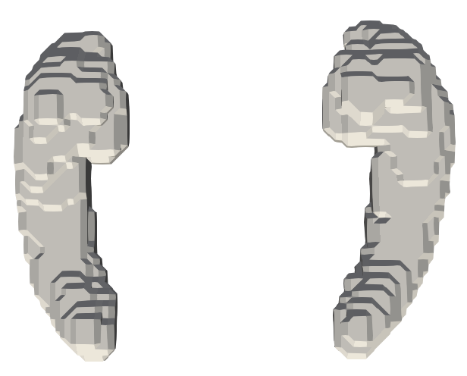
Preprocessing
Image to Mesh: Without sharp edges and surface spikes, but still „blocky“.

Slide 15
Preprocessing
Image Level
Padding
Distance Transform
Gaussian Blur
Image to Mesh
Marching Cubes
Mesh Level
Surface Smoothing
Procrustes Superimposion

Slide 16
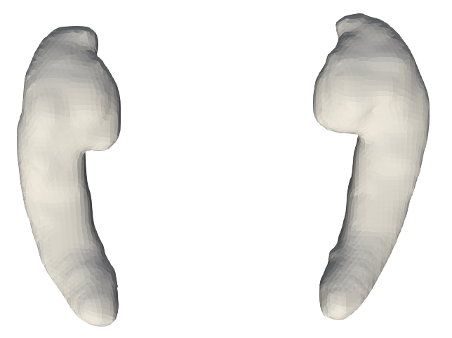
Preprocessing
Laplacian surface smoothing
after
before

Slide 17
Preprocessing – Procrustes Superimposition
“The shape of an object is the geometric information that remains after removal of positional, rotational, and scaling effects¹.”
[1]: Statistical Shape Analysis (Dryden et al.)
1. Translation
2. Scaling
3. Rotation

Slide 18
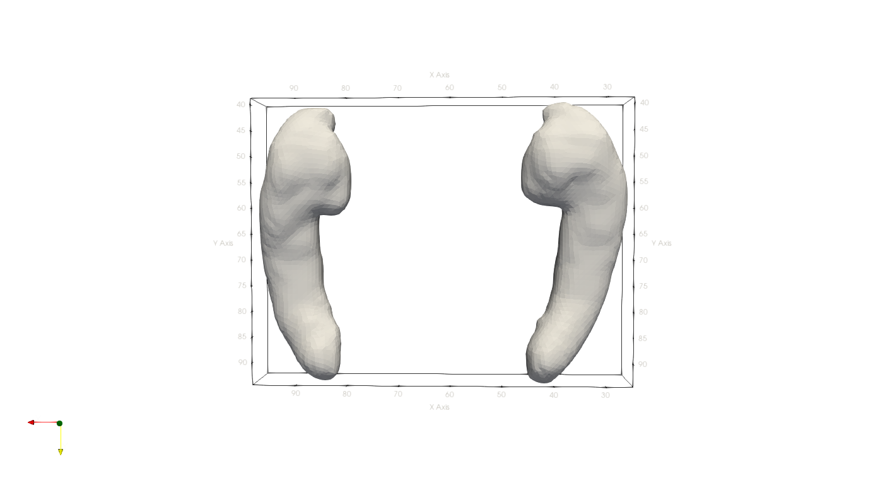

Preprocessing – Procrustes Superimposition
“The shape of an object is the geometric information that remains after removal of positional, rotational, and scaling effects¹.”
Procrustes superimposition: Translation
[1]: Statistical Shape Analysis (Dryden et al.)
after
before

Slide 19

Preprocessing – Procrustes Superimposition
“The shape of an object is the geometric information that remains after removal of positional, rotational, and scaling effects¹.”
Procrustes superimposition: Scaling
[1]: Statistical Shape Analysis (Dryden et al.)
after
before

Slide 20
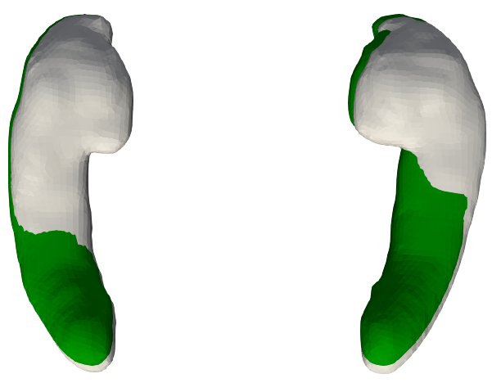
Preprocessing – Procrustes Superimposition
“The shape of an object is the geometric information that remains after removal of positional, rotational, and scaling effects¹.”
Procrustes superimposition: Rotation
[1]: Statistical Shape Analysis (Dryden et al.)
after rotation
before rotation

Slide 21
Raw Data
Preprocessing
Shape Analysis
linear
non-linear
ShapeWorks
Variational Graph AE
Particle Based Model
Mesh Registration
(Supervised) PCA
Supervised Disentangling
Latent
Reconstruction
Latent
Reconstruction
Evaluation

Slide 22
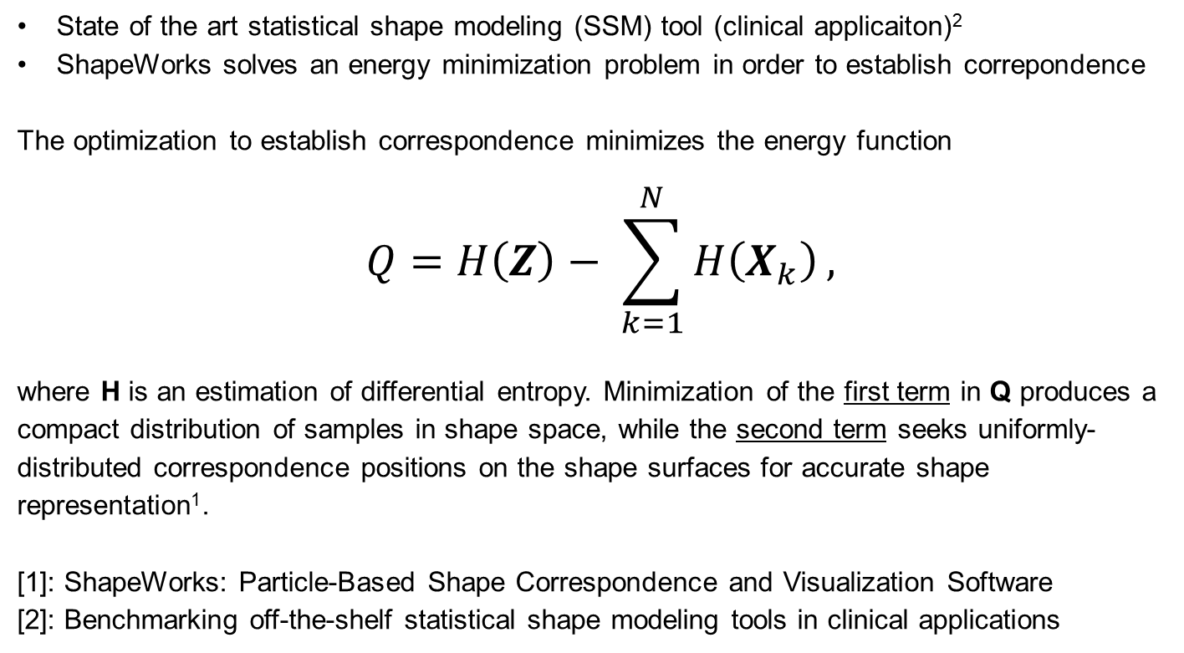
Shape Analysis – ShapeWorks¹
State of the art statistical shape modeling (SSM) tool (clinical application)²
ShapeWorks solves an energy minimization problem in order to establish correspondence
The optimization to establish correspondence minimizes the energy function
$$Q=H\left(Z\right)− \sum_{k=1}^{N}{H\left(X_{k}\right)},$$
where H is an estimation of differential entropy. Minimization of the first term in Q produces a compact distribution of samples in shape space, while the second term seeks uniformly-distributed correspondence positions on the shape surfaces for accurate shape representation¹.
[1]: ShapeWorks: Particle-Based Shape Correspondence and Visualization Software
[2]: Benchmarking off-the-shelf statistical shape modeling tools in clinical applications

Slide 23
Raw Data
Preprocessing
Shape Analysis
linear
non-linear
ShapeWorks
Variational Graph AE
Particle Based Model
Mesh Registration
(Supervised) PCA
Supervised Disentangling
Latent
Reconstruction
Latent
Reconstruction
Evaluation

Slide 24
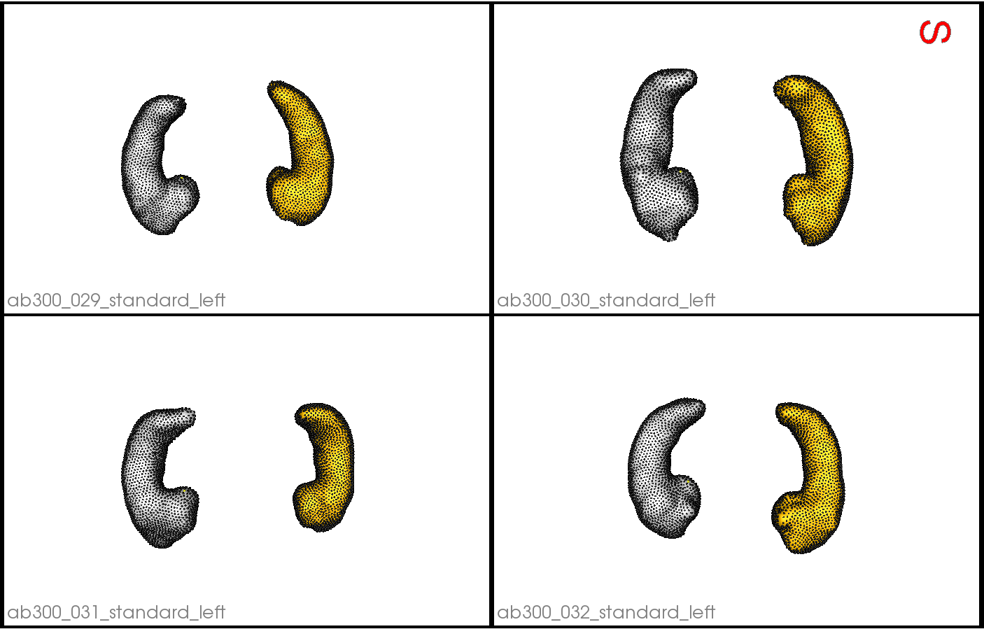
Shape Analysis – Particle Based Model

Slide 25
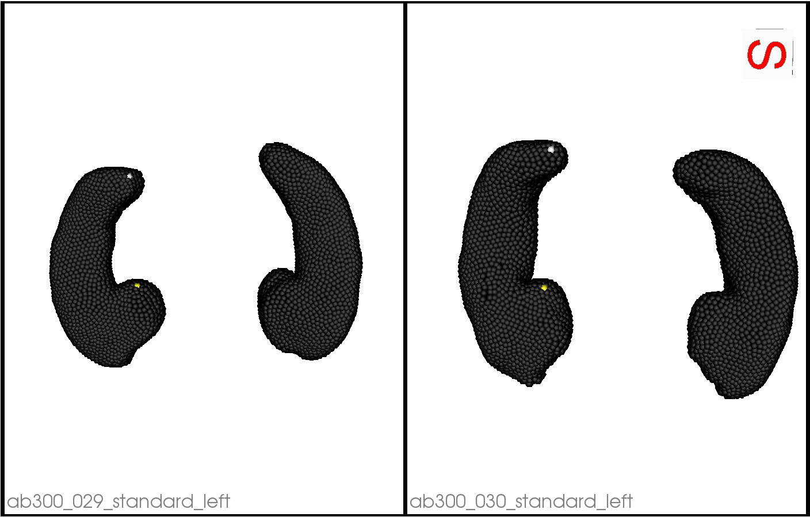
Shape Analysis – Particle Based Model (cont‘d)

Slide 26
Shape Analysis – Particle Based Model (cont‘d)
Open Question:
How to evaluate correpondence besides visual inspection?

Slide 27
Raw Data
Preprocessing
Shape Analysis
linear
non-linear
ShapeWorks
Variational Graph AE
Particle Based Model
Mesh Registration
(Supervised) PCA
Supervised Disentangling
Latent
Reconstruction
Latent
Reconstruction
Evaluation

Slide 28
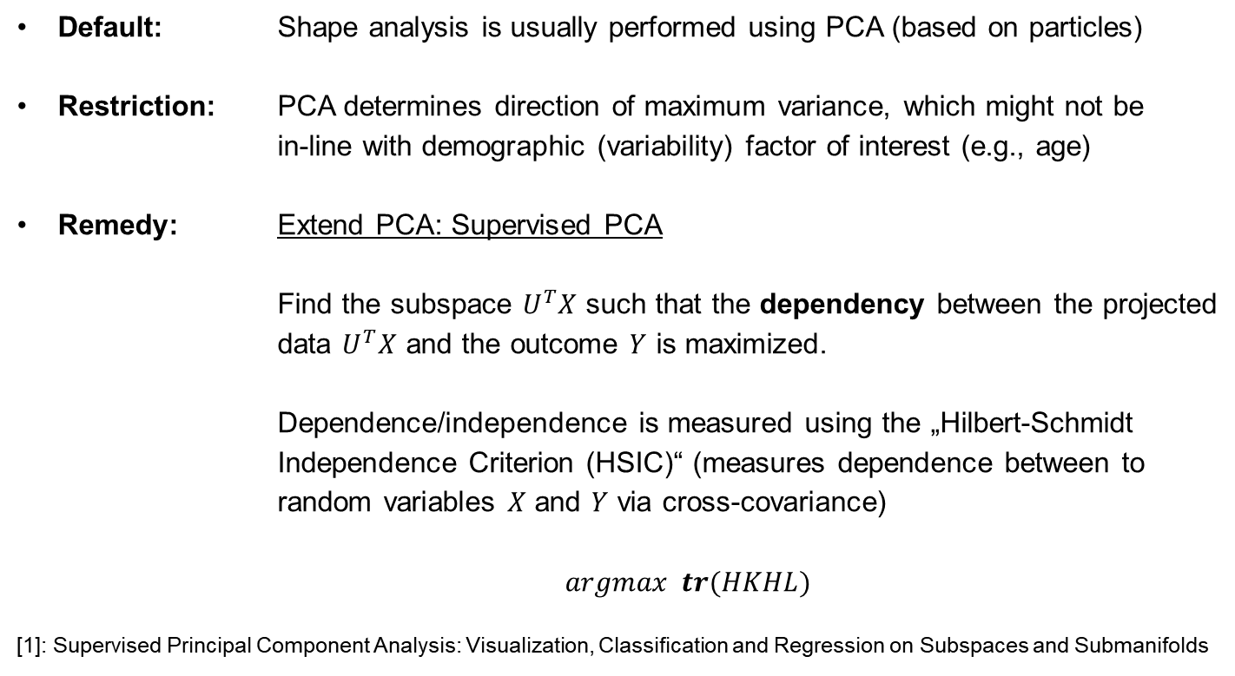
Shape Analysis – (Supervised) PCA¹
Default: Shape analysis is usually performed using PCA (based on particles)
Restriction: PCA determines direction of maximum variance, which might not be in-line with demographic (variability) factor of interest (e.g., age)
Remedy: Extend PCA: Supervised PCA Find the subspace $U^{T}X$ such that the dependency between the projected data $U^{T}X$ and the outcome $Y$ is maximized.
Dependence/independence is measured using the „Hilbert-Schmidt Independence Criterion (HSIC)“ (measures dependence between to random variables $X$ and $Y$ via cross-covariance)
$argmax tr(HKHL)$
[1]: Supervised Principal Component Analysis: Visualization, Classification and Regression on Subspaces and Submanifolds

Slide 29
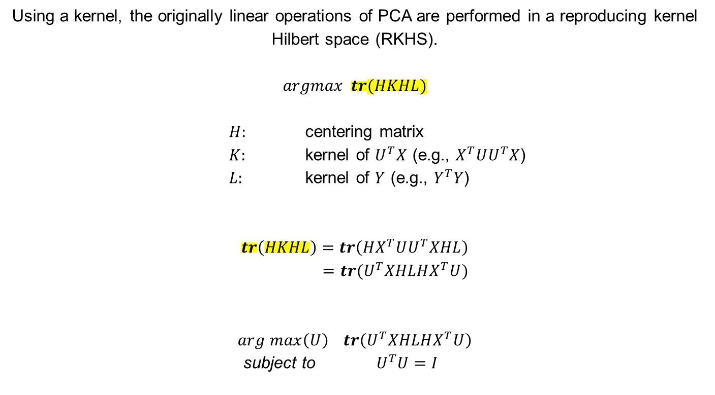
Shape Analysis – (Supervised) PCA (cont‘d)
Using a kernel, the originally linear operations of PCA are performed in a reproducing kernel Hilbert space (RKHS).
$$argmax tr(HKHL)$$
$H:$ centering matrix
$K:$ kernel of $U^{T}X$ (e.g., $X^{T}UU^{T}X$)
$L:$ kernel of $Y$ (e.g., $Y^{T}Y$)
$$tr\left(HKHL\right)=tr\left(HX^{T}UU^{T}XHL\right) \\ =tr(U^{T}XHLHX^{T}U)$$
$$arg max\left(U\right) tr\left(U^{T}XHLHX^{T}U\right)$$
subject to ${ U}^{T}U=I$

Slide 30
Raw Data
Preprocessing
Shape Analysis
linear
non-linear
ShapeWorks
Variational Graph AE
Particle Based Model
Mesh Registration
(Supervised) PCA
Supervised Disentangling
Latent
Reconstruction
Latent
Reconstruction
Evaluation

Slide 31
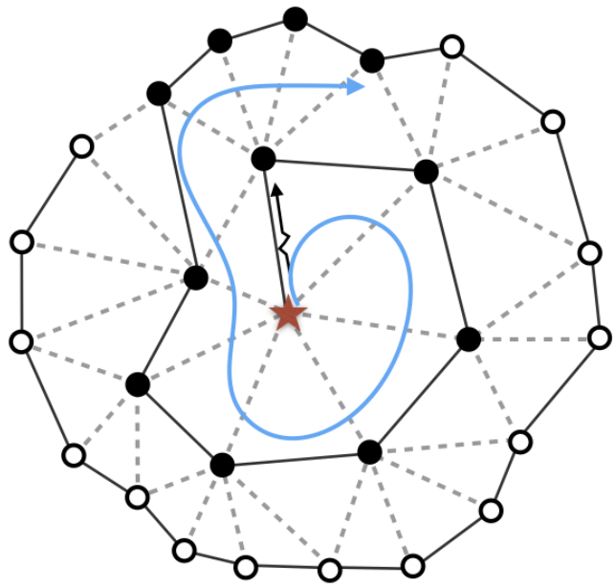





Shape Analysis - Variational Graph AE
Building blocks:
1. Variational autoencoder:
„Auto-Encoding Variational Bayes (Kingma et al.)“
2. Graph convolution:
„SpiralNet++: A Fast and Highly Efficient Mesh Convolution Operator (Ding et al.)”
μ
$$x$$
$$f_{φ}(x)$$
$${ g}_{θ}(z)$$
$$\hat{x}$$
σ
$$z$$

Slide 32
Raw Data
Preprocessing
Shape Analysis
linear
non-linear
ShapeWorks
Variational Graph AE
Particle Based Model
Mesh Registration
(Supervised) PCA
Supervised Disentangling
Latent
Reconstruction
Latent
Reconstruction
Evaluation

Slide 33
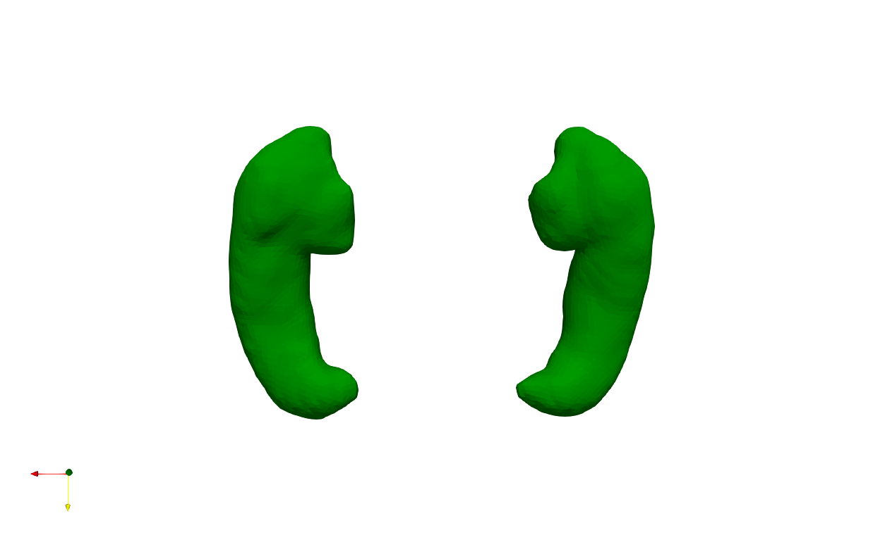
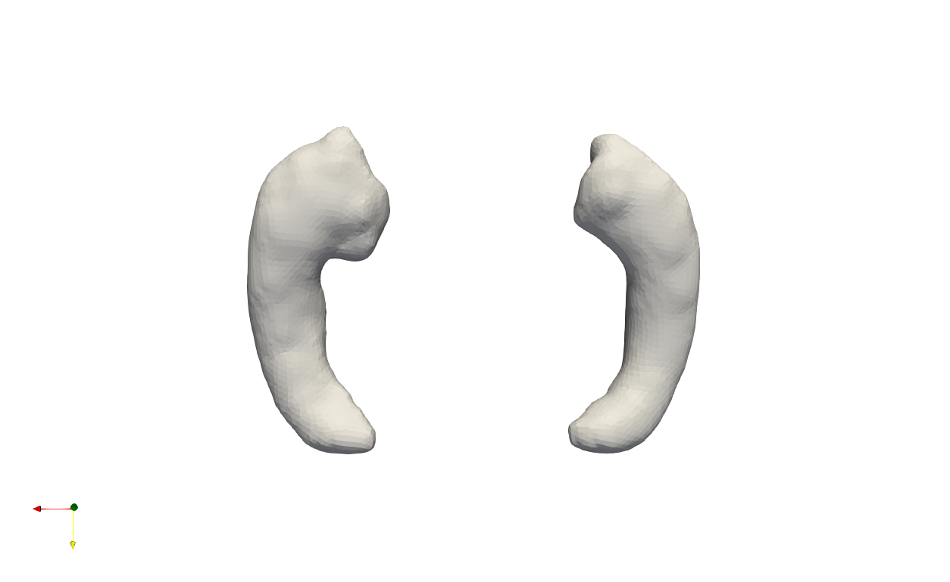
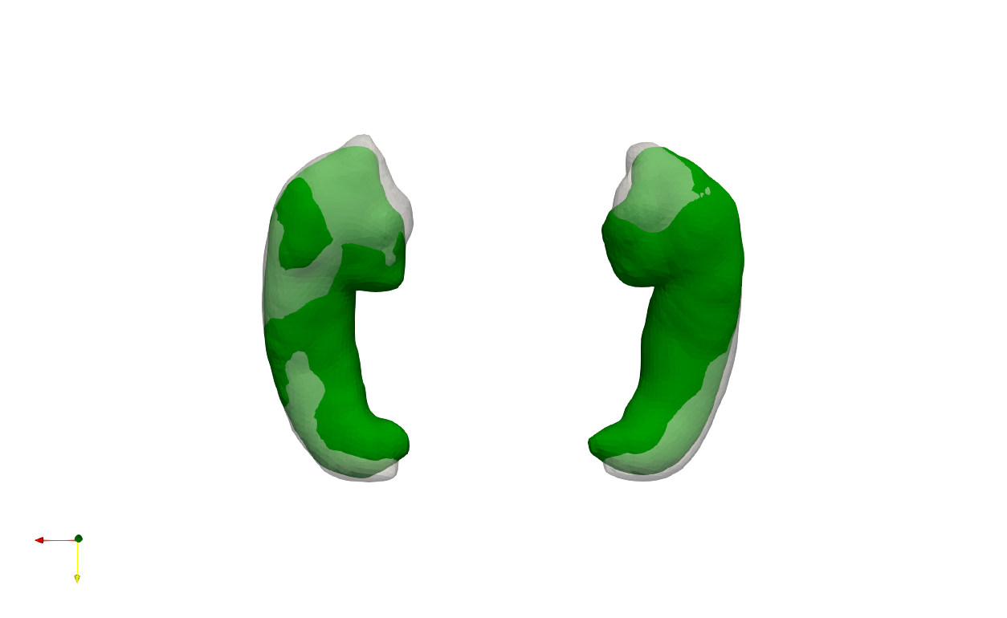
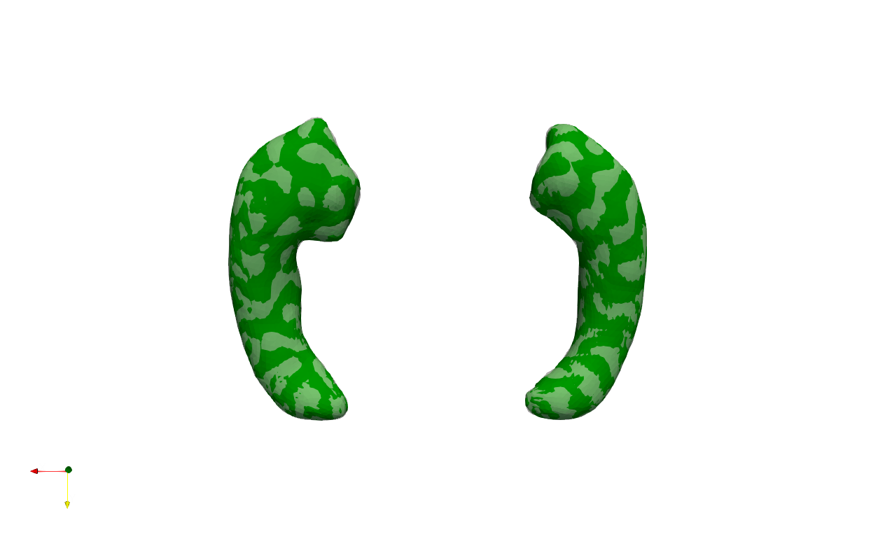
Shape Analysis – Mesh Registration
Source
(Template)
Initial
alignment
Target
Registration
An example of non-rigid registration, where the source 3D mesh is deformed in a non-rigid manner to align with the target mesh (original).

Slide 34
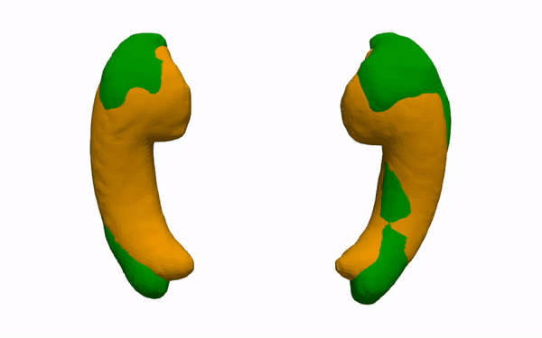
Shape Analysis – Mesh Registration (cont‘d)
original
reconstruction
An example of non-rigid registration, where the source 3D mesh is deformed in a non-rigid manner to align with the target mesh (original).

Slide 35
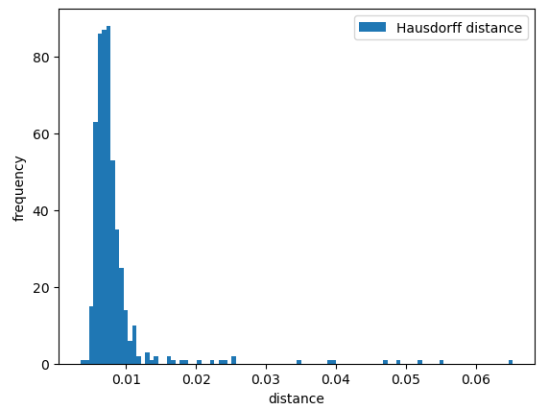
Shape Analysis – Mesh Registration (cont‘d)
mean | 0.008291 mm
std | 0.005706 mm
min | 0.003470 mm
max | 0.065281mm
25% | 0.006288 mm
50% | 0.007197 mm
75% | 0.008268 mm

Slide 36
Raw Data
Preprocessing
Shape Analysis
linear
non-linear
ShapeWorks
Variational Graph AE
Particle Based Model
Mesh Registration
(Supervised) PCA
Supervised Disentangling
Latent
Reconstruction
Latent
Reconstruction
Evaluation

Slide 37

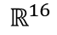


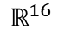
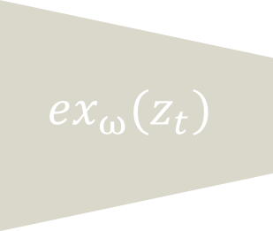

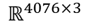

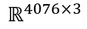
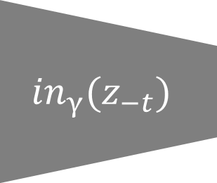


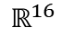
Shape Analysis – Supervised Disentangling¹
${ex}_{ω}(z_{t})$
$$\hat{y}$$
μ
$$x$$
$$f_{φ}(x)$$
$$ℝ^{16}$$
$$g_{θ}(z)$$
$$\hat{x}$$
$$ℝ^{4076×3}$$
σ
$$ℝ^{4076×3}$$
$$ℝ^{16}$$
${in}_{γ}(z_{−t})$
$$z$$
$$ℝ^{16}$$
$$\hat{y}$$
[1] Guided Variational Autoencoder for Disentanglement Learning

Slide 38
Raw Data
Preprocessing
Shape Analysis
linear
non-linear
ShapeWorks
Variational Graph AE
Particle Based Model
Mesh Registration
(Supervised) PCA
Supervised Disentangling
Latent
Reconstruction
Latent
Reconstruction
Evaluation

Slide 39
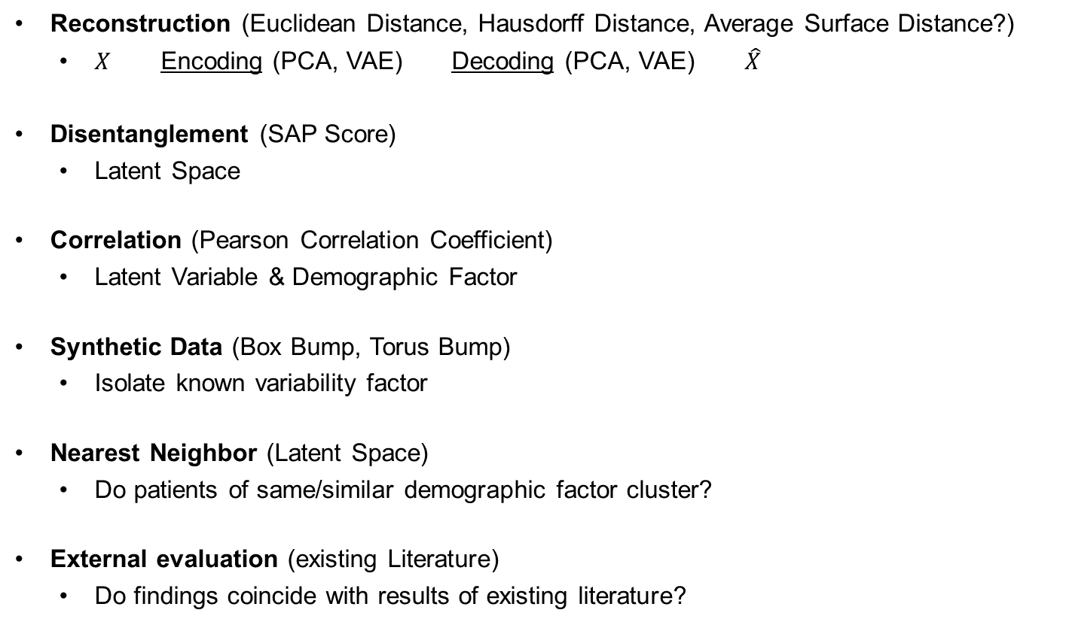
Evaluation
Reconstruction (Euclidean Distance, Hausdorff Distance, Average Surface Distance?)
$X$ Encoding (PCA, VAE) Decoding (PCA, VAE) $\hat{X}$
Disentanglement (SAP Score)
Latent Space
Correlation (Pearson Correlation Coefficient)
Latent Variable & Demographic Factor
Synthetic Data (Box Bump, Torus Bump)
Isolate known variability factor
Nearest Neighbor (Latent Space)
Do patients of same/similar demographic factor cluster?
External evaluation (existing Literature)
Do findings coincide with results of existing literature?

Slide 40
Evaluation - Reconstruction
ShapeWorks: 128 Particles
left hippocampus
count | 511
mean | 1.911934
std | 0.544364
min | 0.994431
25% | 1.539933
50% | 1.826775
75% | 2.161419
max | 5.761616
right hippocampus
count | 511
mean | 1.880930
std | 0.728277
min | 0.944780
25% | 1.463483
50% | 1.739056
75% | 2.112896
max | 10.07225
left+right
count | 511
mean | 3.792864
std | 1.053466
min | 2.205766
25% | 3.162045
50% | 3.611618
75% | 4.157137
max | 11.66452

Slide 41
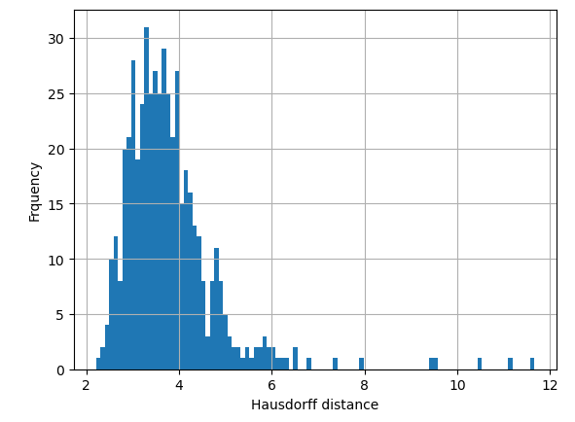
Evaluation - Reconstruction
ShapeWorks: 128 Particles

Slide 42
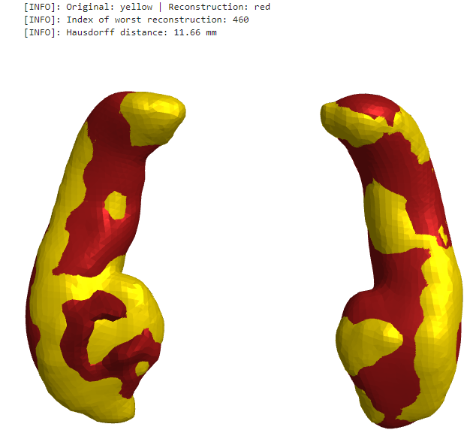
Evaluation - Reconstruction
ShapeWorks: 128 Particles
Worst reconstruction

Slide 43
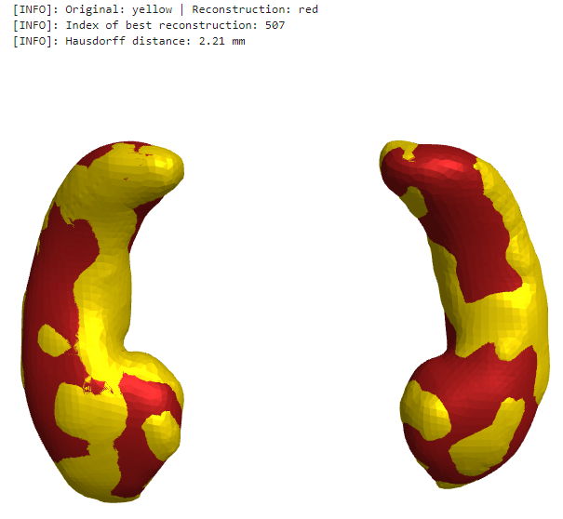
Evaluation - Reconstruction
ShapeWorks: 128 Particles
Best reconstruction

Slide 44
Evaluation - Reconstruction
ShapeWorks: 256 Particles
left hippocampus
count | 511
mean | 1.492576
std | 0.544053
min | 0.731870
25% | 1.209811
50% | 1.382551
75% | 1.621278
max | 5.933058
right hippocampus
count | 511
mean | 1.496831
std | 0.530433
min | 0.830350
25% | 1.193992
50% | 1.390820
75% | 1.621889
max | 4.807875
left+right
count | 511
mean | 2.989408
std | 0.934428
min | 1.714106
25% | 2.517441
50% | 2.819683
75% | 3.170500
max | 10.36046

Slide 45
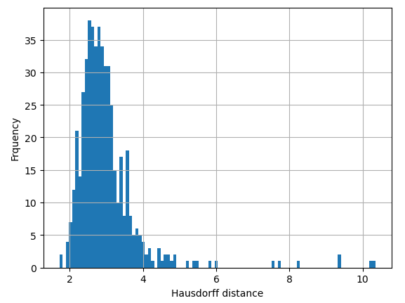
Evaluation - Reconstruction
ShapeWorks: 256 Particles

Slide 46
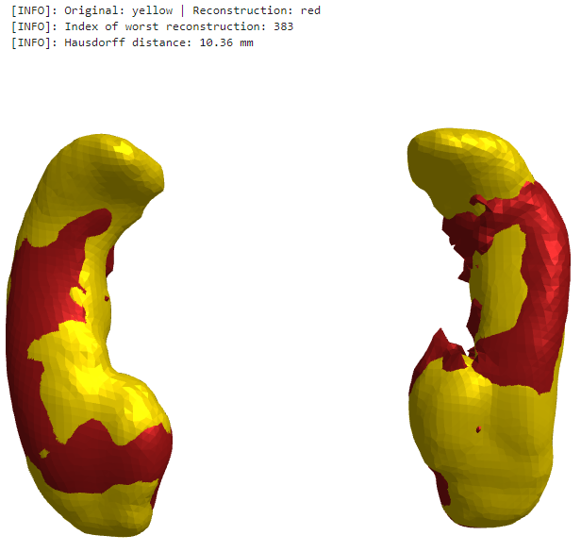
Evaluation - Reconstruction
ShapeWorks: 256 Particles
Worst reconstruction

Slide 47
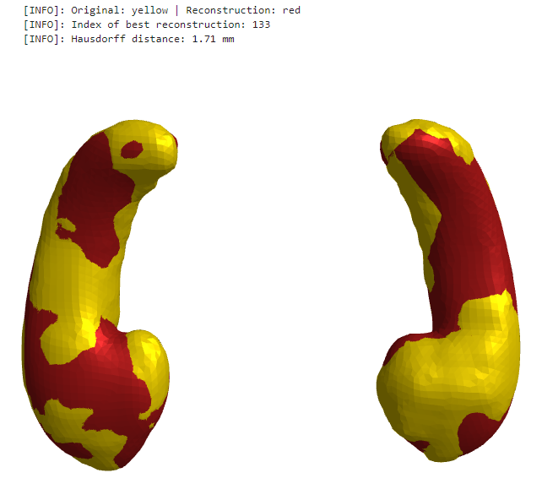
Evaluation - Reconstruction
ShapeWorks: 256 Particles
Best reconstruction

Slide 48
Evaluation - Reconstruction
ShapeWorks: 512 Particles
left hippocampus
count | 511
mean | 1.425057
std | 0.519784
min | 0.767203
25% | 1.171511
50% | 1.341203
75% | 1.538682
max | 8.049070
right hippocampus
count | 511
mean | 1.436473
std | 0.527689
min | 0.790931
25% | 1.156270
50% | 1.325273
75% | 1.559751
max | 6.575357
left+right
count | 511
mean | 2.861529
std | 0.879865
min | 1.647571
25% | 2.444044
50% | 2.693581
75% | 3.061921
max | 10.97323

Slide 49
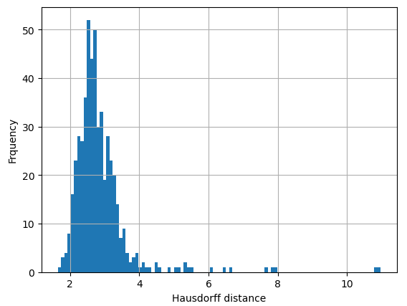
Evaluation - Reconstruction
ShapeWorks: 512 Particles

Slide 50
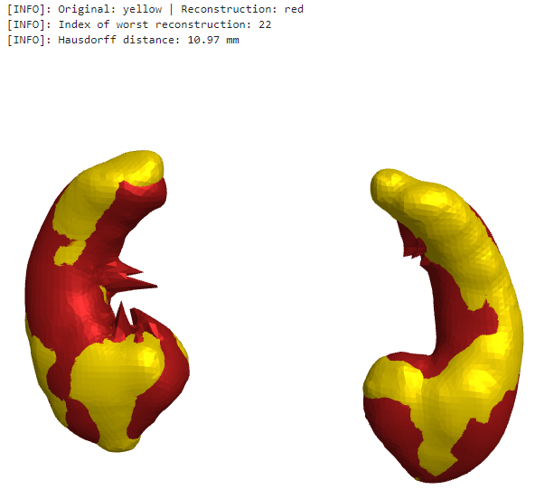
Evaluation - Reconstruction
ShapeWorks: 512 Particles
Worst reconstruction

Slide 51
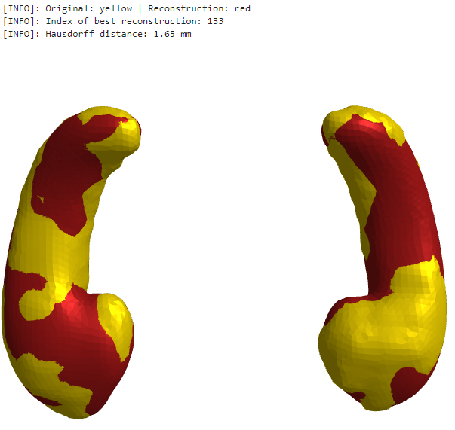
Evaluation - Reconstruction
ShapeWorks: 512 Particles
Best reconstruction

Slide 52
Evaluation - Reconstruction
ShapeWorks: 1024 Particles
left hippocampus
count | 511
mean | 1.417865
std | 0.422372
min | 0.730079
25% | 1.170535
50% | 1.340432
75% | 1.553495
max | 5.137917
right hippocampus
count | 511
mean | 1.642660
std | 3.220589
min | 0.828782
25% | 1.167533
50% | 1.331491
75% | 1.546366
max | 64.87295
left+right
count | 511
mean | 3.060526
std | 3.330845
min | 1.760234
25% | 2.459069
50% | 2.707966
75% | 3.045935
max | 67.02798

Slide 53
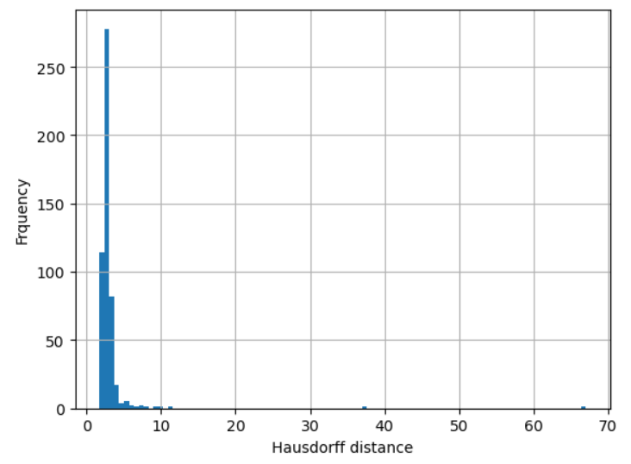
Evaluation - Reconstruction
ShapeWorks: 1024 Particles

Slide 54
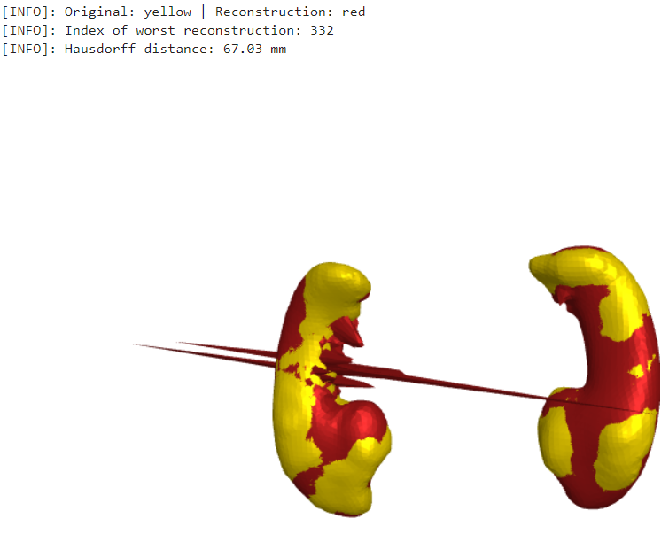
Evaluation - Reconstruction
ShapeWorks: 1024 Particles
Worst reconstruction

Slide 55
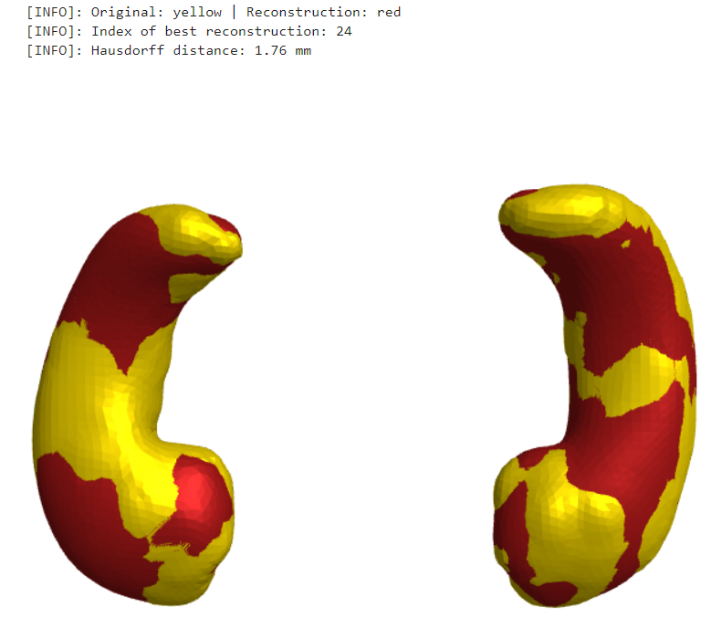
Evaluation - Reconstruction
ShapeWorks: 1024 Particles
Best reconstruction

Slide 56
Evaluation - Reconstruction
ShapeWorks: 2048 Particles
left hippocampus
count | 511
mean | 1.529045
std | 1.769585
min | 0.724902
25% | 1.173240
50% | 1.335729
75% | 1.540049
max | 34.47863
right hippocampus
count | 511
mean | 1.497926
std | 0.911290
min | 0.821274
25% | 1.147854
50% | 1.329433
75% | 1.559007
max | 9.942331
left+right
count | 511
mean | 3.026971
std | 2.216178
min | 1.758059
25% | 2.433748
50% | 2.714382
75% | 3.041462
max | 40.80588

Slide 57
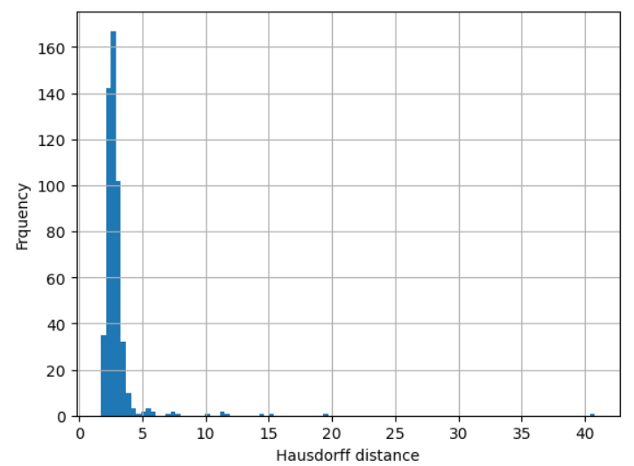
Evaluation - Reconstruction
ShapeWorks: 2048 Particles

Slide 58
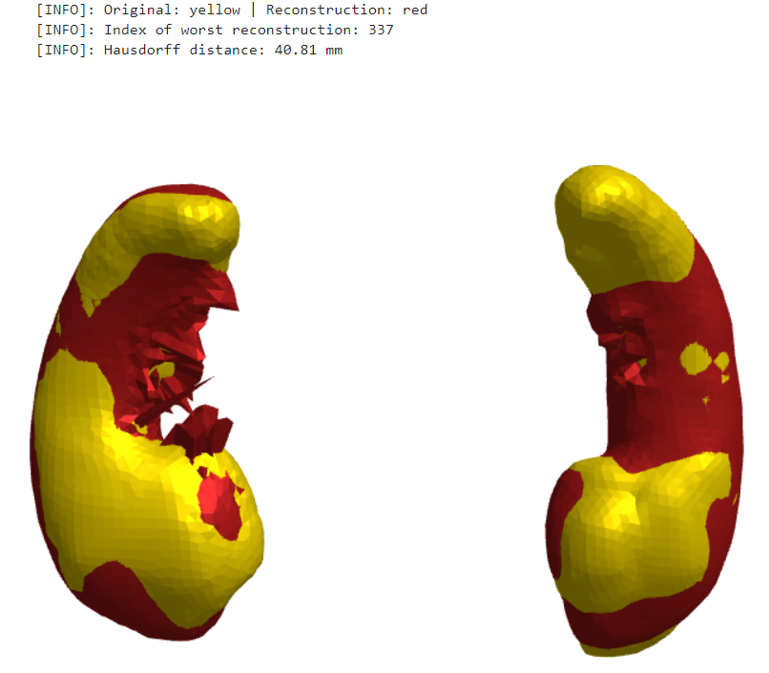
Evaluation - Reconstruction
ShapeWorks: 2048 Particles
Worst reconstruction

Slide 59
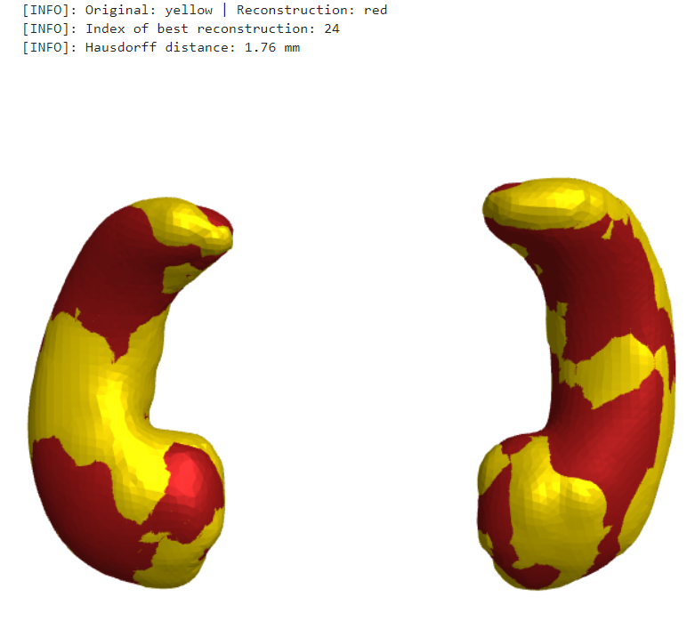
Evaluation - Reconstruction
ShapeWorks: 2048 Particles
Best reconstruction

Slide 60
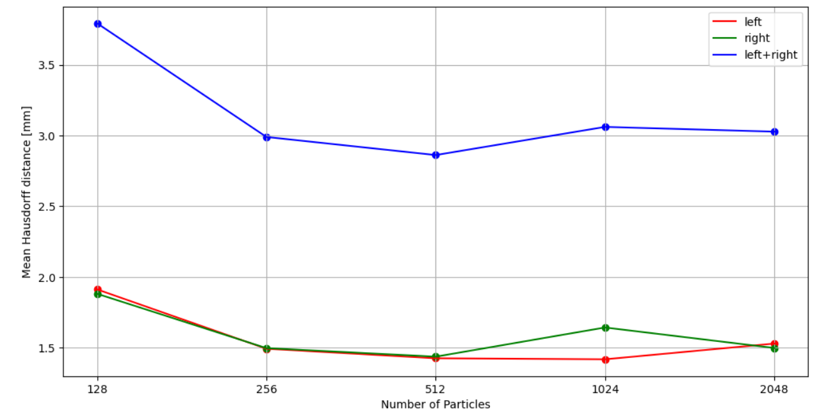
Evaluation - Reconstruction

Slide 61
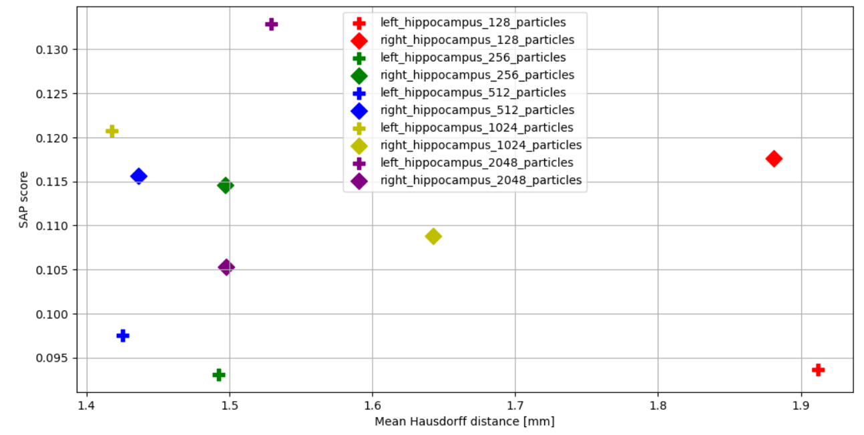
Evaluation – Disentanglement

Slide 62
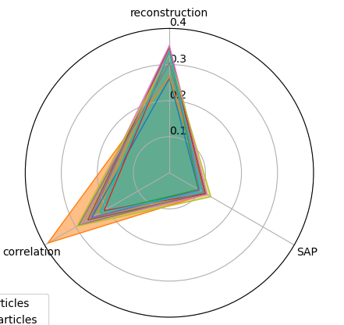
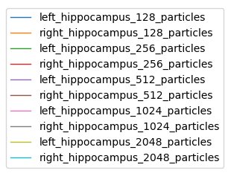
Evaluation – Disentanglement

Slide 63
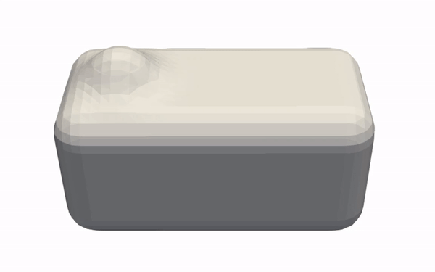

Evaluation – Synthetic Data
Box-Bump
Torus-Bump

Slide 64

Evaluation

